Slide 1
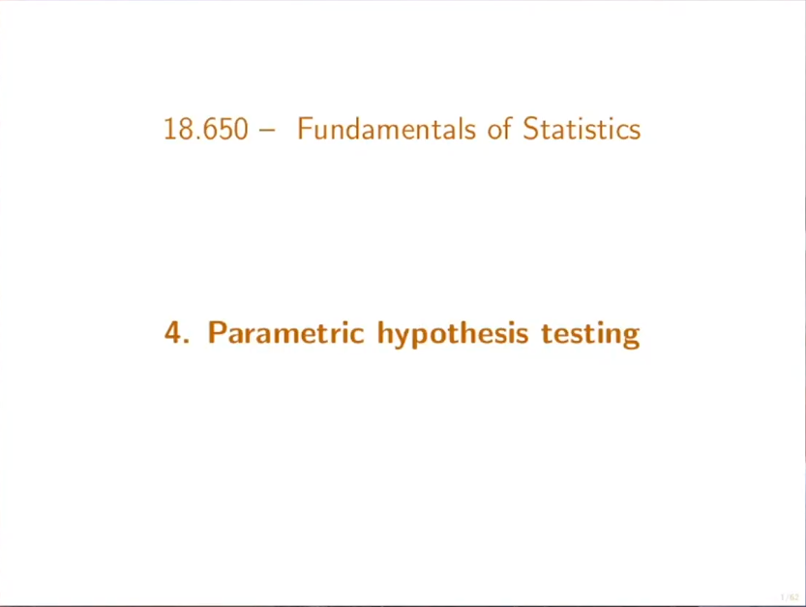

Slide 2
Objectives At the end of this lecture, you will be able to do the following:
Reformulate experimental questions in terms of a hypothesis test by specifying an appropriate null hypothesis and an alternative hypothesis .
Design statistical tests to decide between a null and alternative hypothesis.
Understand the types of error of a test
Compute the power function of a test
Design statistical tests with a specific level or asymptotic level.
Apply a test to a given sample to determine whether or not the null hypothesis should be rejected.
Compute a test from a confidence interval
Compute and interpret the p-value associated to a statistical test.

Slide 3
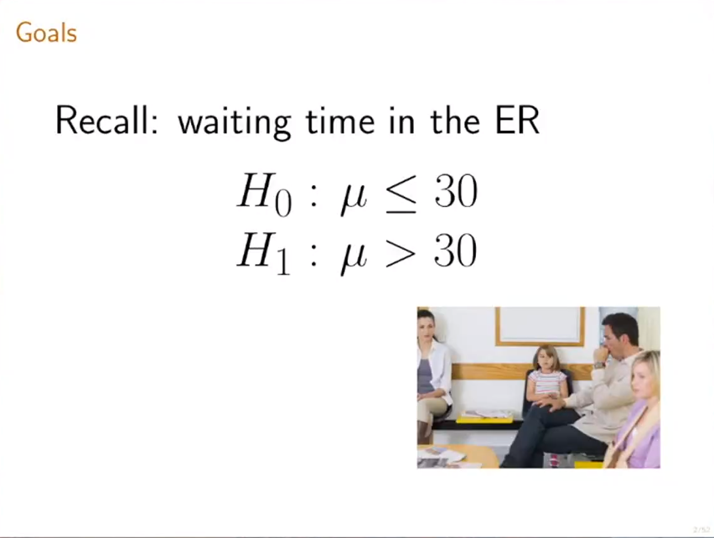

Slide 4
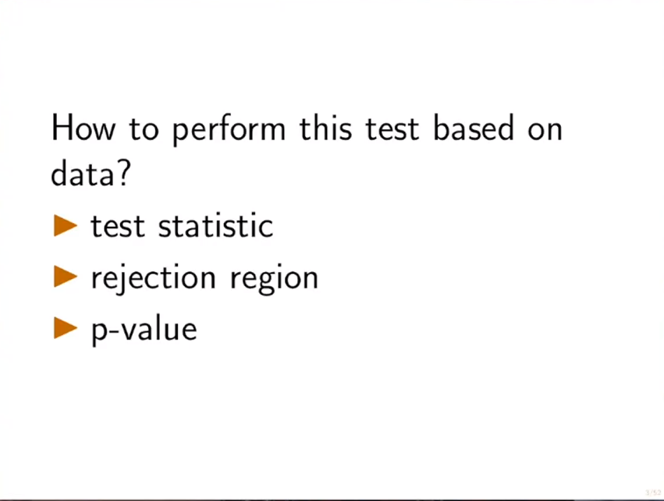

Slide 5
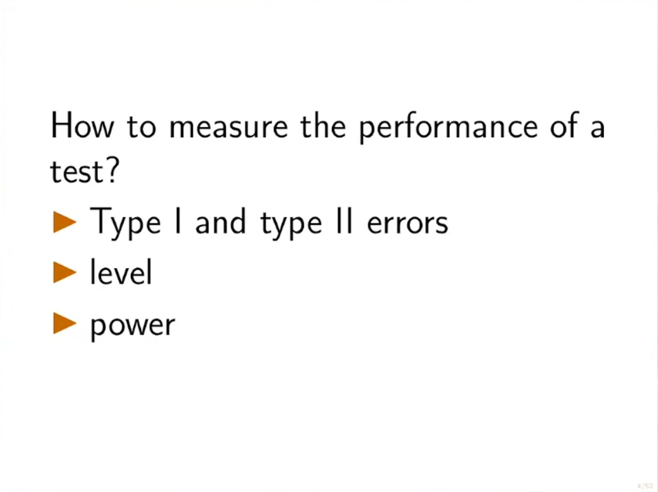

Slide 6
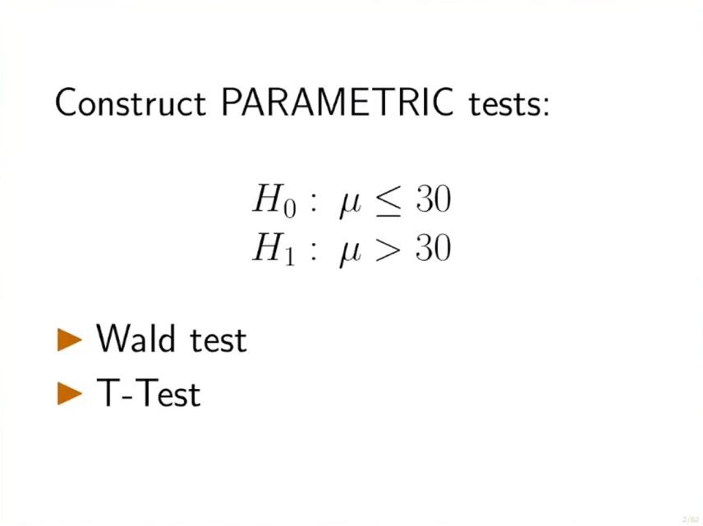

Slide 7
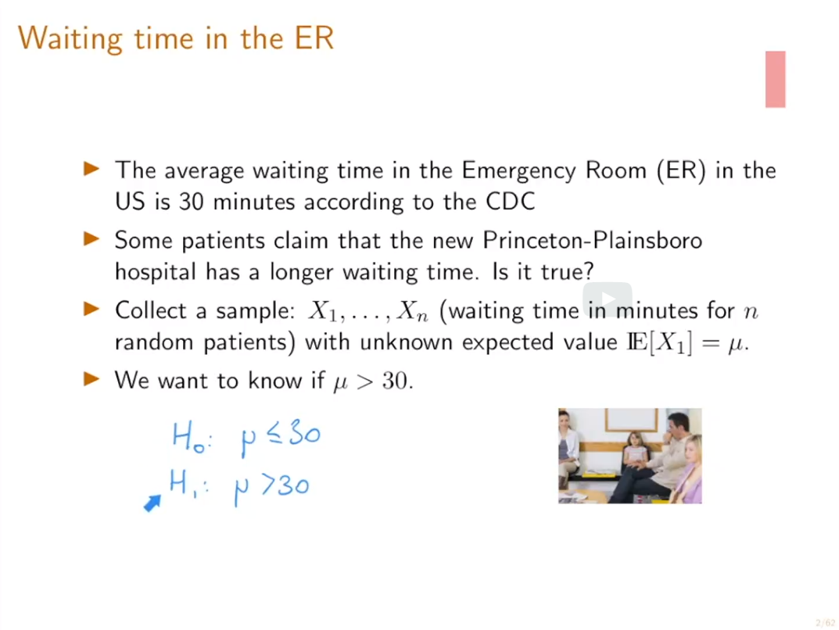

Slide 8
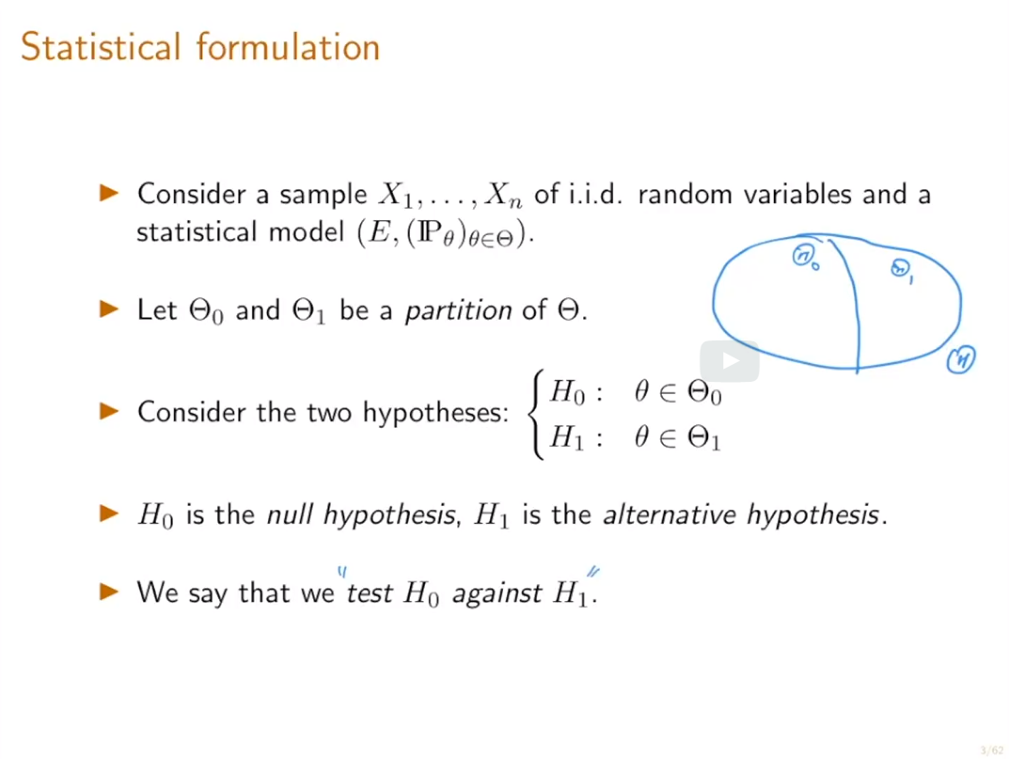

Slide 9
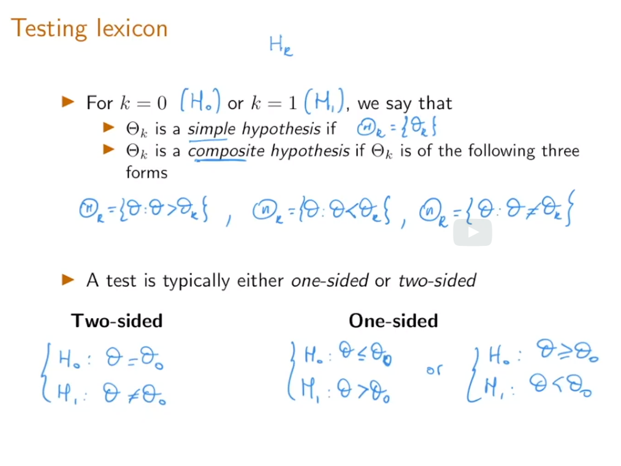

Slide 10
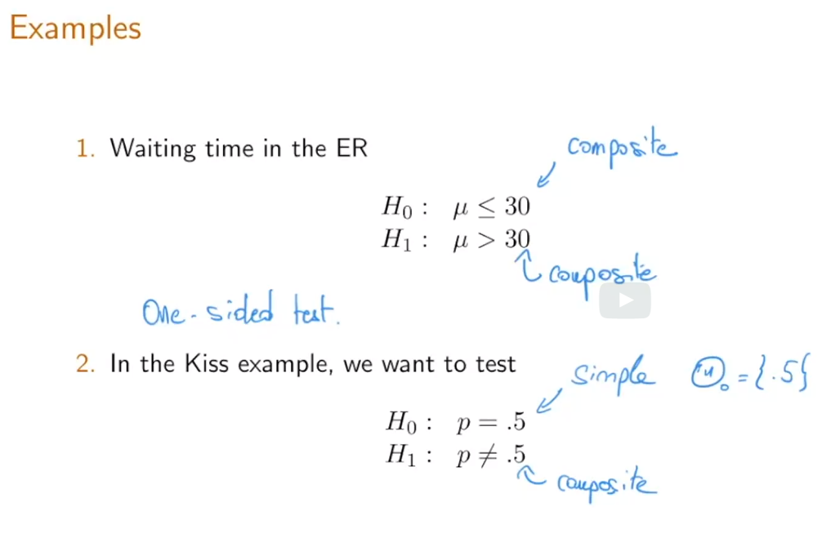

Slide 11
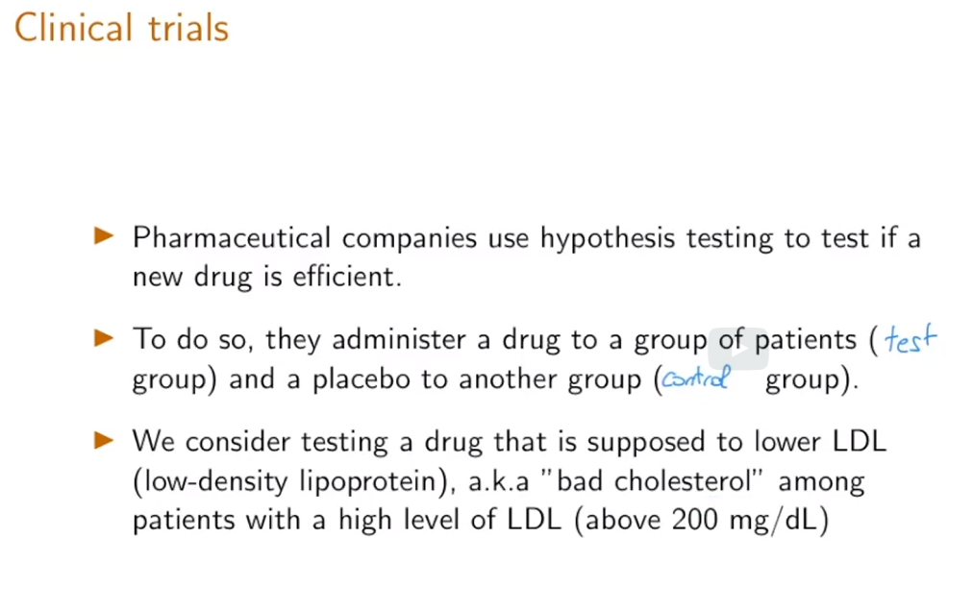

Slide 12
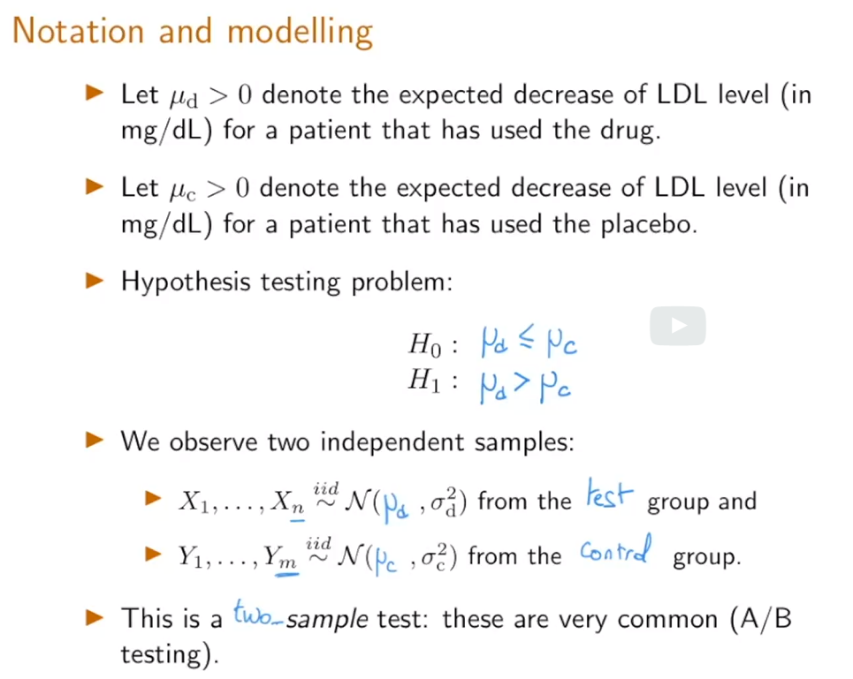

Slide 13
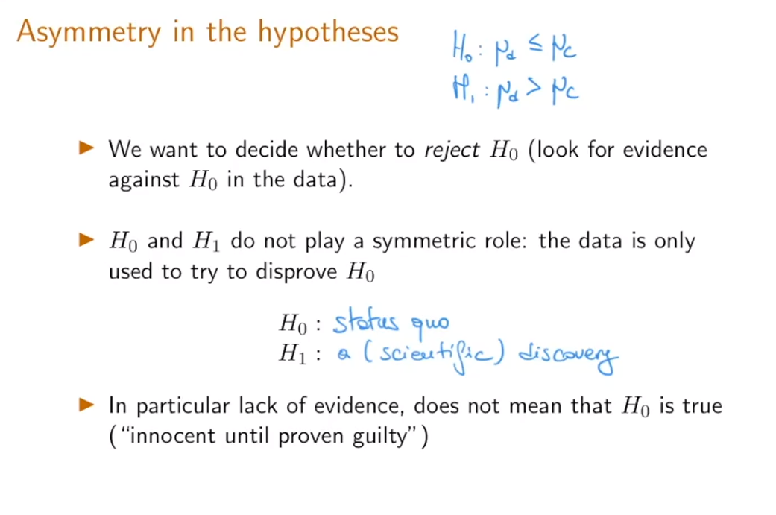

Slide 14
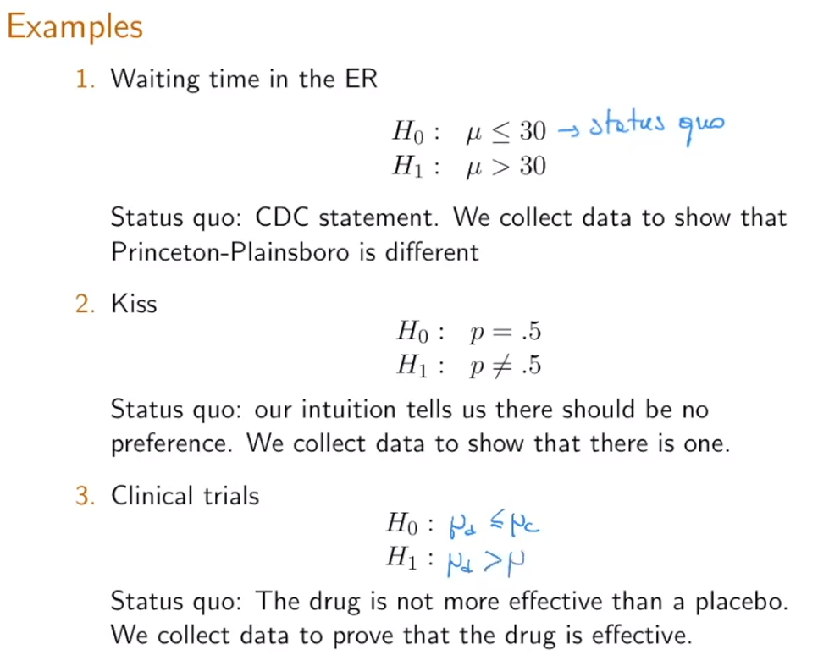

Slide 15
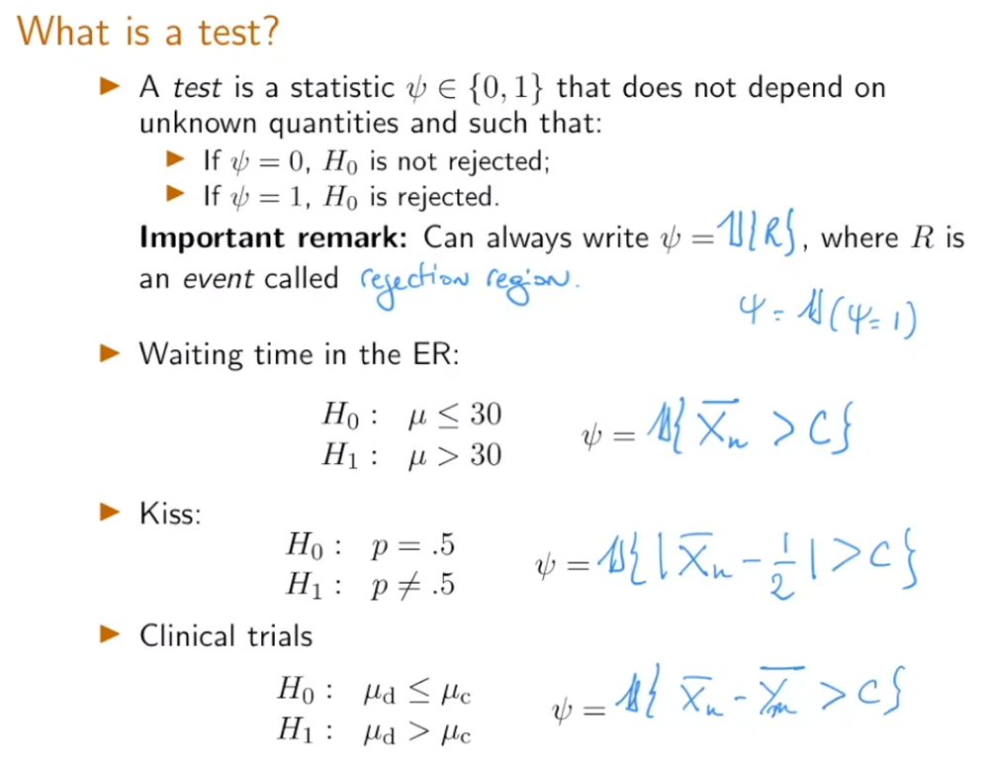

Slide 16
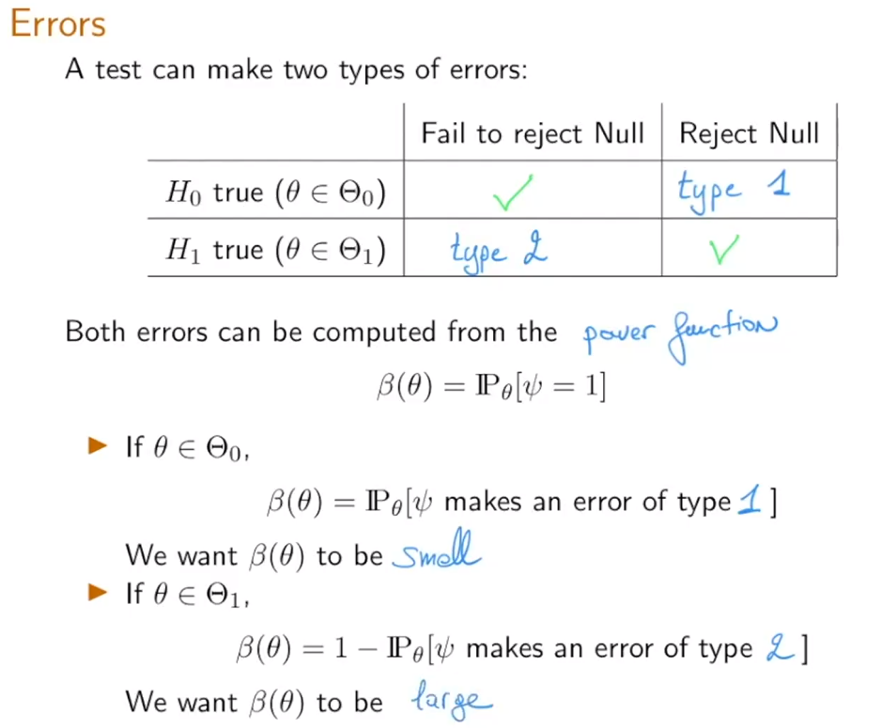

Slide 17
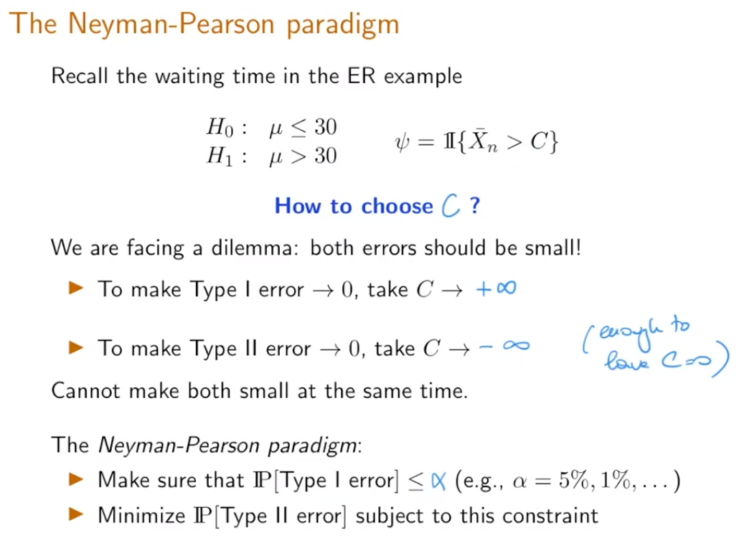

Slide 18
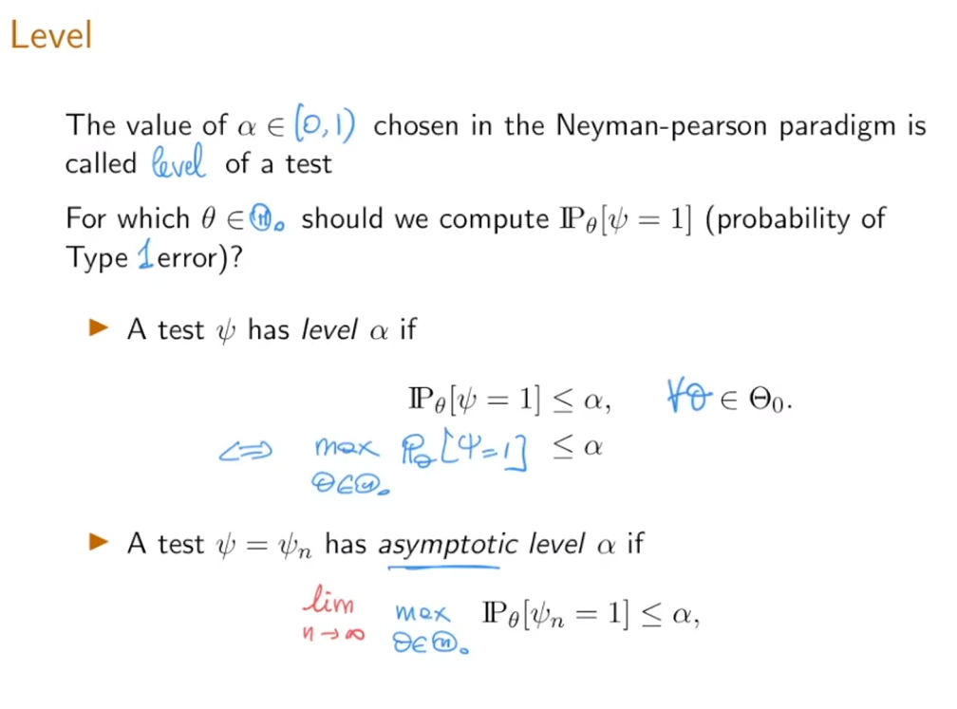

Slide 19
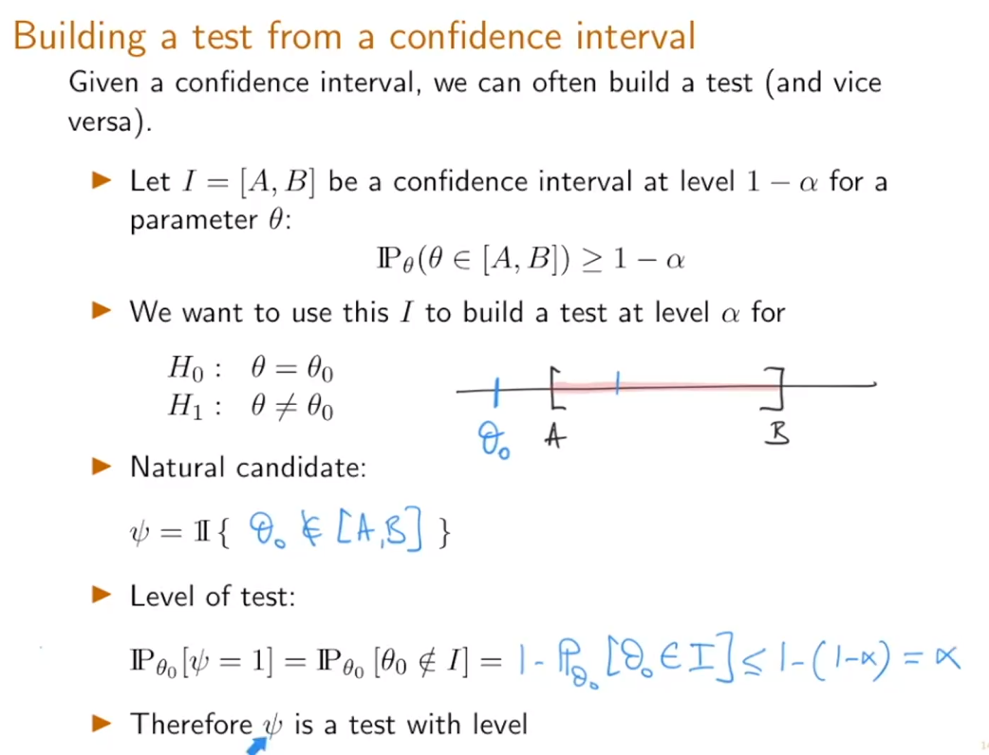

Slide 20
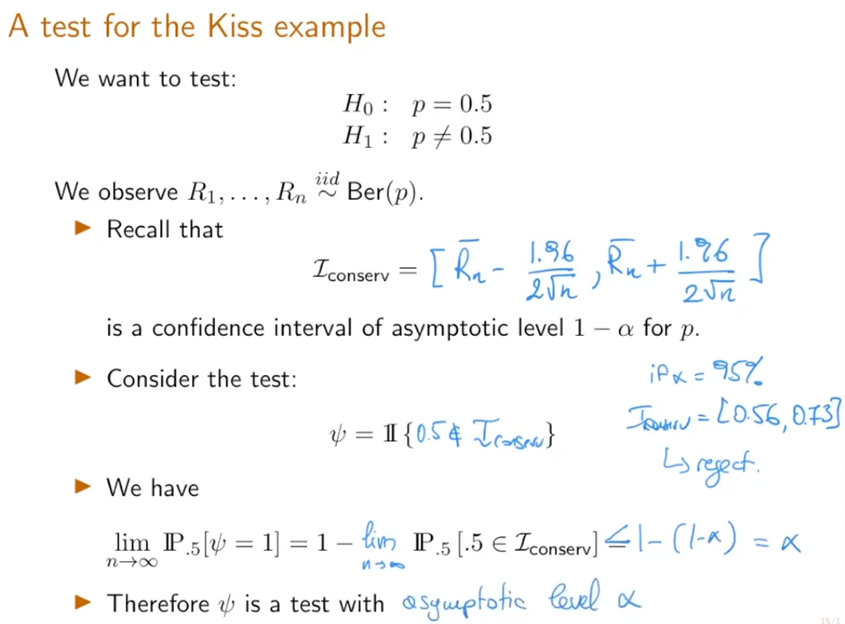

Slide 21
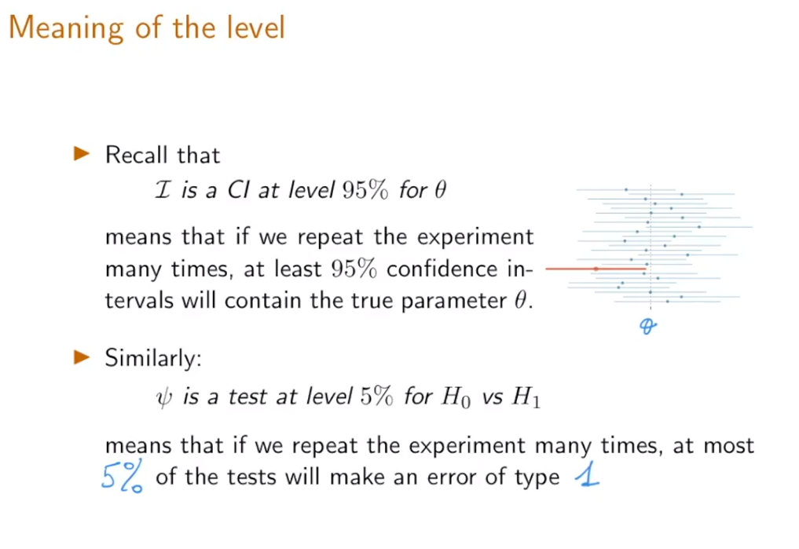

Slide 22
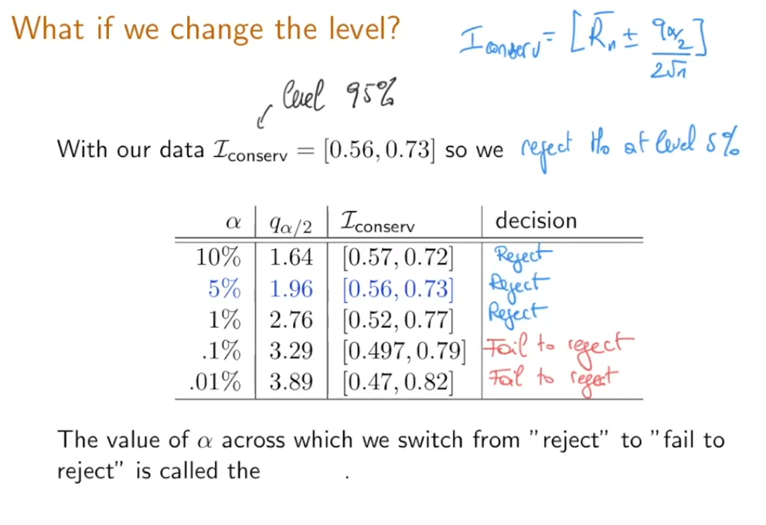

Slide 23
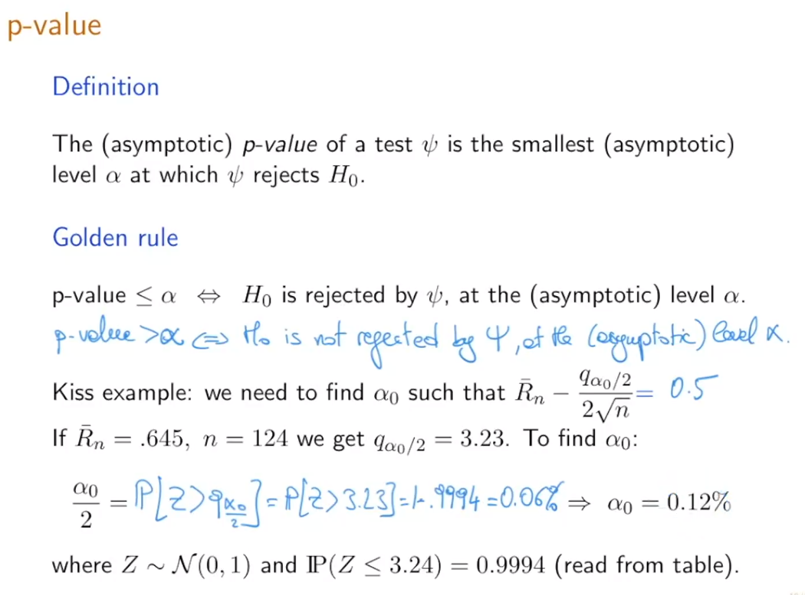

Slide 24
